Slide 1


Chapter 11
Approximation
Algorithms
Slides by Kevin Wayne.
Copyright @ 2005 Pearson-Addison Wesley.
All rights reserved.

Slide 2
Approximation Algorithms
Q. Suppose I need to solve an NP-hard problem. What should I do?
A. Theory says you're unlikely to find a poly-time algorithm.
Must sacrifice one of three desired features.
  Solve problem to optimality.
  Solve problem in poly-time.
  Solve arbitrary instances of the problem.
ρ-approximation algorithm.
  Guaranteed to run in poly-time.
  Guaranteed to solve arbitrary instance of the problem
  Guaranteed to find solution within ratio ρ of true optimum.
Challenge. Need to prove a solution's value is close to optimum, without even knowing what optimum value is!

Slide 3
11.1 Load Balancing

Slide 4
Load Balancing
Input. m identical machines; n jobs, job j has processing time t_{j}.
  Job j must run contiguously on one machine.
  A machine can process at most one job at a time.
Def. Let J(i) be the subset of jobs assigned to machine i. The
load of machine i is L_{i} = Σ_{j ∈ J(i)} t_{j}.
Def. The makespan is the maximum load on any machine L = max_{i} L_{i}.
Load balancing. Assign each job to a machine to minimize makespan.

Slide 5
Load Balancing: List Scheduling
List-scheduling algorithm (Greedy based algorithm).
  Consider n jobs in some fixed order.
  Assign job j to machine whose load is smallest so far.
Implementation. O(n log m) using a priority queue.
List-Scheduling(m, n, t₁,t₂,…,t_{n}) {
for i = 1 to m {
L_{i} ← 0
J(i) ← φ
}
for j = 1 to n {
i = argmin_{k} L_{k}
J(i) ← J(i) ∪ {j}
L_{i} ← L_{i} + t_{j}
}
return J(1), …, J(m)
}
load on machine i
jobs assigned to machine i
machine i has smallest load
assign job j to machine i
update load of machine i
Notes:
Remark. This is an "on-line" algorithm.

Slide 6

Load Balancing: List Scheduling Analysis
Theorem. [Graham, 1966] Greedy algorithm is a 2-approximation.
  First worst-case analysis of an approximation algorithm.
  Need to compare resulting solution with optimal makespan L*.
Lemma 1. The optimal makespan L* ≥ max_{j} t_{j}.
Pf. Some machine must process the most time-consuming job. ▪
Lemma 2. The optimal makespan
Pf.
  The total processing time is Σ_{j} t_{j} .
  One of m machines must do at least a 1/m fraction of total work. ▪
Notes:
Need to compare greedy solution with optimal makespan. Need good lower bounds on the optimal value.
Lower bound too weak in following case: one job is extremely long relative to sum of all processing times. If sufficiently extreme, optimal solution will place long job on a machine all by itself and it will be last to finish. In this case, greedy will do well, but first lower bound will not establish this.

Slide 7
Load Balancing: List Scheduling Analysis
Theorem. Greedy algorithm is a 2-approximation.
Pf. Consider load L_{i} of bottleneck machine i.
  Let j be last job scheduled on machine i.
  When job j assigned to machine i, i had smallest load. Its load before assignment is L_{i} - t_{j} ⇒ L_{i} - t_{j} ≤ L_{k} for all 1 ≤ k ≤ m.
blue jobs scheduled before j
machine i
j
0
L_{i} - t_{j}
L = L_{i}

Slide 8
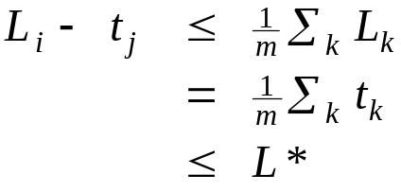
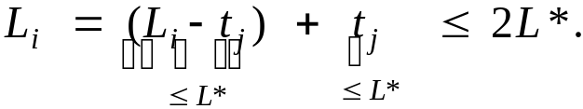
Load Balancing: List Scheduling Analysis
Theorem. Greedy algorithm is a 2-approximation.
Pf. Consider load L_{i} of bottleneck machine i.
  Let j be last job scheduled on machine i.
  When job j assigned to machine i, i had smallest load. Its load before assignment is L_{i} - t_{j} ⇒ L_{i} - t_{j} ≤ L_{k} for all 1 ≤ k ≤ m.
  Sum inequalities over all k and divide by m:
  Now ▪
  Q. Is our analysis tight?
k=1,…,m
k=1,…,n
Lemma 1
Lemma 2

Slide 9
Load Balancing: List Scheduling Analysis
Q. Is our analysis tight?
A. Essentially yes.
Ex: m machines, m(m-1) jobs length 1 jobs, one job of length m
machine 2 idle
machine 3 idle
machine 4 idle
m = 10
machine 5 idle
machine 6 idle
machine 7 idle
machine 8 idle
machine 9 idle
machine 10 idle
list scheduling makespan = 19

Slide 10
Load Balancing: List Scheduling Analysis
Q. Is our analysis tight?
A. Essentially yes.
Ex: m machines, m(m-1) jobs length 1 jobs, one job of length m
m = 10
optimal makespan = 10

Slide 11
Load Balancing: LPT Rule
Longest processing time (LPT). Sort n jobs in descending order of processing time, and then run list scheduling algorithm.
(intuition: We want to add the last job not poking out that much)
LPT-List-Scheduling(m, n, t₁,t₂,…,t_{n}) {
Sort jobs so that t₁ ≥ t₂ ≥ … ≥ t_{n}
for i = 1 to m {
L_{i} ← 0
J(i) ← φ
}
for j = 1 to n {
i = argmin_{k} L_{k}
J(i) ← J(i) ∪ {j}
L_{i} ← L_{i} + t_{j}
}
return J(1), …, J(m)
}
load on machine i
jobs assigned to machine i
machine i has smallest load
assign job j to machine i
update load of machine i

Slide 12
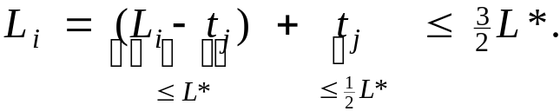
Load Balancing: LPT Rule
Observation. If at most m jobs, then list-scheduling is optimal.
Pf. Each job put on its own machine. ▪
Lemma 3. If there are more than m jobs, L* ≥ 2 t_{m+1}.
Pf.
  Consider first m+1 jobs t₁, …, t_{m+1}.
  Since the t_{i}'s are in descending order, each takes at least t_{m+1} time.
  There are m+1 jobs and m machines, so by pigeonhole principle, at least one machine gets two jobs. ▪
Theorem. LPT rule is a 3/2 approximation algorithm.
Pf. Same basic approach as for list scheduling.
▪
Lemma 3
( by observation, can assume number of jobs > m )
Notes:
j = last job scheduled on bottleneck machine.

Slide 13
Load Balancing: LPT Rule
Q. Is our 3/2 analysis tight?
A. No.
Theorem. [Graham, 1969] LPT rule is a 4/3-approximation.
Pf. More sophisticated analysis of same algorithm.
Q. Is Graham's 4/3 analysis tight?
A. Essentially yes.
Ex: m machines, n = 2m+1 jobs, 2 jobs of length m+1, m+2, …, 2m-1 and one job of length m.
Notes:
Best known: PTAS, 4/3-analysis not too hard

Slide 14
11.2 Center Selection

Slide 15
Center Selection Problem
Input. Set of n sites s₁, …, s_{n} and integer k > 0.
Center selection problem. Select k centers C so that maximum distance from a site to nearest center is minimized.
k = 4
r(C)
center
site

Slide 16
Center Selection Problem
Input. Set of n sites s₁, …, s_{n} and integer k > 0.
Center selection problem. Select k centers C so that maximum distance from a site to nearest center is minimized.
Notation.
  dist(x, y) = distance between x and y.
  dist(s_{i}, C) = min _{c ∈ C} dist(s_{i}, c) = distance from s_{i} to closest center.
  r(C) = max_{i} dist(s_{i}, C) = smallest covering radius.
Goal. Find set of centers C that minimizes r(C), subject to |C| = k.
Distance function properties.
  dist(x, x) = 0 (identity)
  dist(x, y) = dist(y, x) (symmetry)
  dist(x, y) ≤ dist(x, z) + dist(z, y) (triangle inequality)
Notes:
Note: if we don't assume weights satisfy the triangle inequality (or put some other restriction on the distances) the problem cannot be approximated
within any computable factor

Slide 17
Center Selection Example
Ex: each site is a point in the plane, a center can be any point in the plane, dist(x, y) = Euclidean distance.
Remark: search can be infinite!
r(C)
center
site

Slide 18
Greedy Algorithm: A False Start
Greedy algorithm. Put the first center at the best possible location for a single center, and then keep adding centers so as to reduce the covering radius each time by as much as possible.
Remark: arbitrarily bad!
greedy center 1
center
k = 2 centers
site

Slide 19
Center Selection: Greedy Algorithm
Greedy algorithm. Repeatedly choose the next center to be the site farthest from any existing center.
Observation. Upon termination all centers in C are pairwise at least r(C) apart.
Pf. By construction of algorithm (considering the last center site s_{k}; it is the site that is furthest away from C - s_{k}).
Greedy-Center-Selection(k, n, s₁,s₂,…,s_{n}) {
C = φ
repeat k times {
Select a site s_{i} with maximum dist(s_{i}, C)
Add s_{i} to C
}
return C
}
site farthest from any center
Notes:
Note: in first iteration, can choose any site s

Slide 20
Center Selection: Analysis of Greedy Algorithm
Theorem. Let C* be an optimal set of centers. Then r(C) ≤ 2r(C*).
Pf. (by contradiction) Assume r(C*) < ½ r(C).
  For each site c_{i} in C, consider ball of radius ½ r(C) around it.
  Exactly one c_{i}* in each ball; let c_{i} be the site paired with c_{i}*.
  Consider any site s and its closest center c_{i}* in C*.
  dist(s, C) ≤ dist(s, c_{i}) ≤ dist(s, c_{i}*) + dist(c_{i}*, c_{i}) ≤ 2r(C*).
  Thus r(C) ≤ 2r(C*). ▪
Δ-inequality
≤ r(C*) since c_{i}* is closest center
½ r(C)
½ r(C)
c_{i}
½ r(C)
C*
sites
c_{i}*
s
Notes:
Why at least one c* in each ball around c? If not, then c would not be within 1/2 r(C) > r(C*) of any center in C* (contradicting the assumption).
Why at most one c* in each bal around c? The balls are disjoint, each ball contains at least one c*, and |C| = |C*|.

Slide 21
Center Selection
Theorem. Let C* be an optimal set of centers. Then r(C) ≤ 2r(C*).
Theorem. Greedy algorithm is a 2-approximation for center selection problem.
Remark. Greedy algorithm always places centers at sites, but is still within a factor of 2 of best solution that is allowed to place centers anywhere.
Question. Is there hope of a 3/2-approximation? 4/3?
e.g., points in the plane
Theorem. Unless P = NP, there no ρ-approximation for center-selection
problem for any ρ < 2 (not proved here).

Slide 22
11.4 The Pricing Method: Vertex Cover

Slide 23
Weighted Vertex Cover
Definition. Given a graph G = (V, E), a vertex cover is a set S ⊆ V such that each edge in E has at least one end in S.
Weighted vertex cover. Given a graph G with vertex weights, find a vertex cover of minimum weight. (NP hard problem)
all nodes with weight of 1 reduces the problem to standard vertex cover problem.
2
4
2
4
2
9
2
9
weight = 2 + 2 + 4
weight = 11

Slide 24
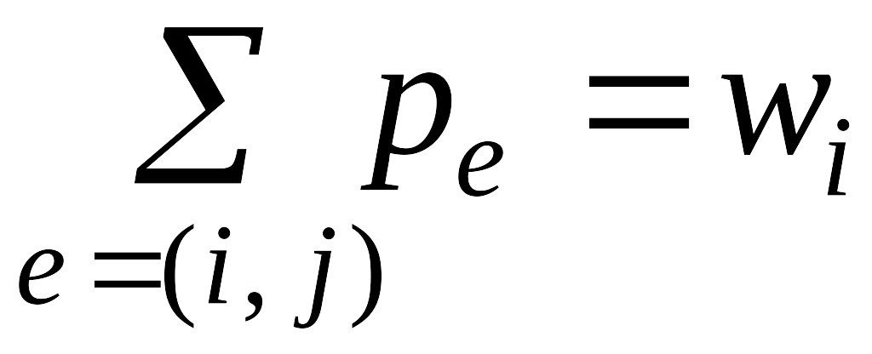
Pricing Method
Pricing method. Set prices and find vertex cover simultaneously.
Why S is a vertex cover set? (use contradiction to prove)
Weighted-Vertex-Cover-Approx(G, w) {
foreach e in E
p_{e} = 0
while (∃ edge e=(i,j) such that neither i nor j are tight)
select such an edge e
increase p_{e} as much as possible until i or j tight
}
S ← set of all tight nodes
return S
}

Slide 25
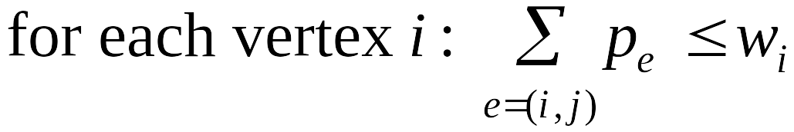
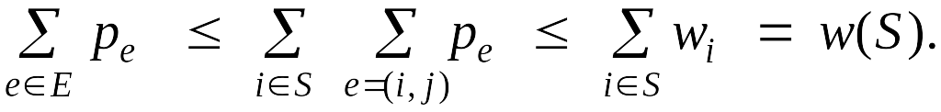
Approximation method: Pricing Method
Pricing method. Each edge must be covered by some vertex.
Edge e = (i, j) pays price p_{e} ≥ 0 to use vertex i and j.
Fairness. Edges incident to vertex i should pay ≤ w_{i} in total.
Lemma. For any vertex cover S and any fair prices p_{e}: ∑_{e} p_{e} ≤ w(S).
Pf. ▪
2
4
2
9
each edge e covered by
at least one node in S
sum fairness inequalities
for each node in S

Slide 26
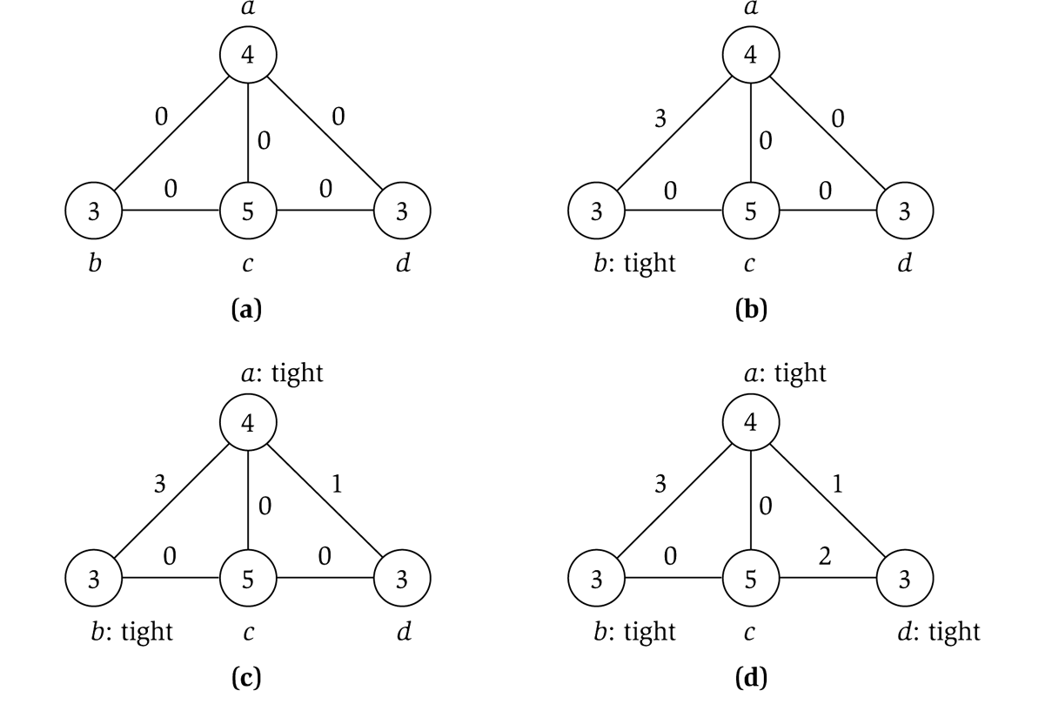
Pricing Method
price of edge a-b
vertex weight
Figure 11.8
Example shows the pricing method does not provide the optimal
weighted vertex cover solution

Slide 27
Pricing Method: Analysis
Theorem. Pricing method is a 2-approximation.
Pf.
  Algorithm terminates since at least one new node becomes tight after each iteration of while loop.
  Let S = set of all tight nodes upon termination of algorithm. S is a vertex cover: if some edge i-j is uncovered, then neither i nor j is tight. But then while loop would not terminate.
  Let S* be optimal vertex cover. We show w(S) ≤ 2w(S*).
all nodes in S are tight
S ⊆ V,
prices ≥ 0
each edge counted twice
fairness lemma

Slide 28
11.6 LP Rounding: Vertex Cover

Slide 29
Weighted Vertex Cover
Weighted vertex cover. Given an undirected graph G = (V, E) with vertex weights w_{i} ≥ 0, find a minimum weight subset of nodes S such that every edge is incident to at least one vertex in S.
10
A
F
9
6
16
B
G
10
7
6
C
H
9
3
23
D
I
33
7
E
J
32
10
total weight = 55
Notes:
min weight vertex cover may not be a min cardinality vertex cover

Slide 30
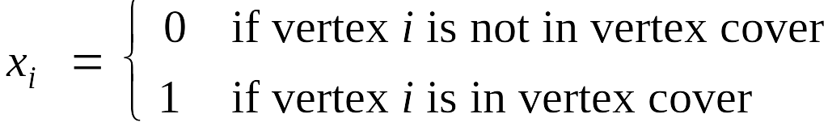
Weighted Vertex Cover: IP Formulation
Weighted vertex cover. Given an undirected graph G = (V, E) with vertex weights w_{i} ≥ 0, find a minimum weight subset of nodes S such that every edge is incident to at least one vertex in S.
Integer programming formulation.
  Model inclusion of each vertex i using a 0/1 variable x_{i}.
  Vertex covers in 1-1 correspondence with 0/1 assignments:
  S = {i ∈ V : x_{i} = 1}
  Objective function: minimize Σ_{i} w_{i} x_{i}.
    Constraints:…..
  Must take either i or j: x_{i} + x_{j} ≥ 1.

Slide 31
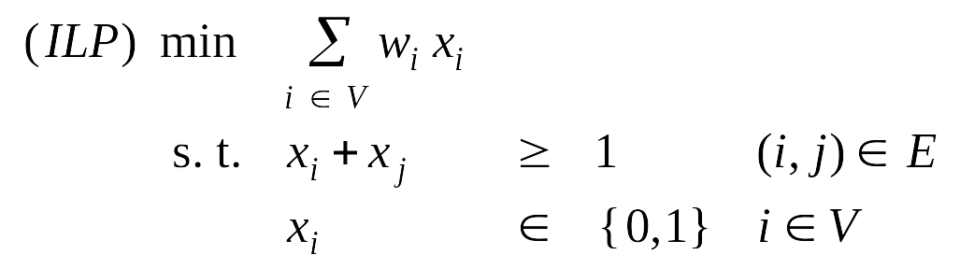
Weighted Vertex Cover: IP Formulation
Weighted vertex cover. Integer programming formulation.
Observation. If x* is optimal solution to (ILP), then S = {i ∈ V : x*_{i} = 1} is a min weight vertex cover.

Slide 32
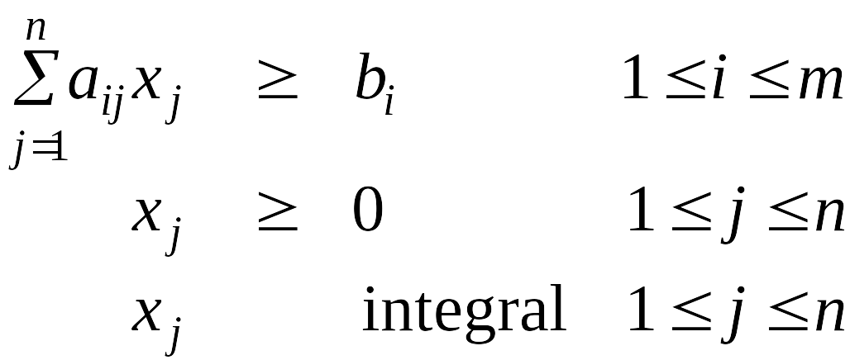
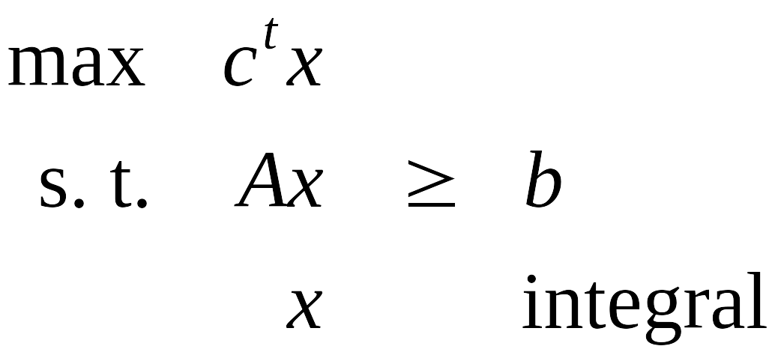
Integer Programming
INTEGER-PROGRAMMING. Given integers a_{ij} and b_{i}, find integers x_{j} that satisfy:
Observation. Vertex cover formulation proves that integer programming is NP-hard search problem.
even if all coefficients are 0/1 and
at most two variables per inequality

Slide 33
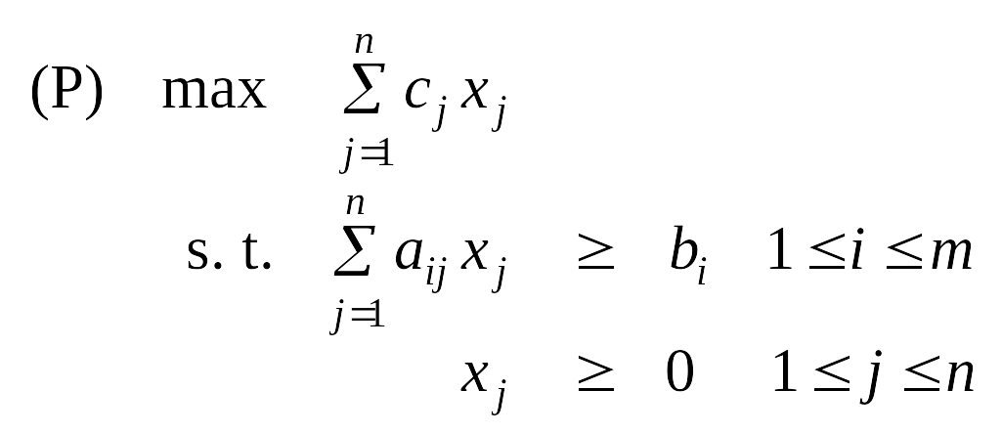
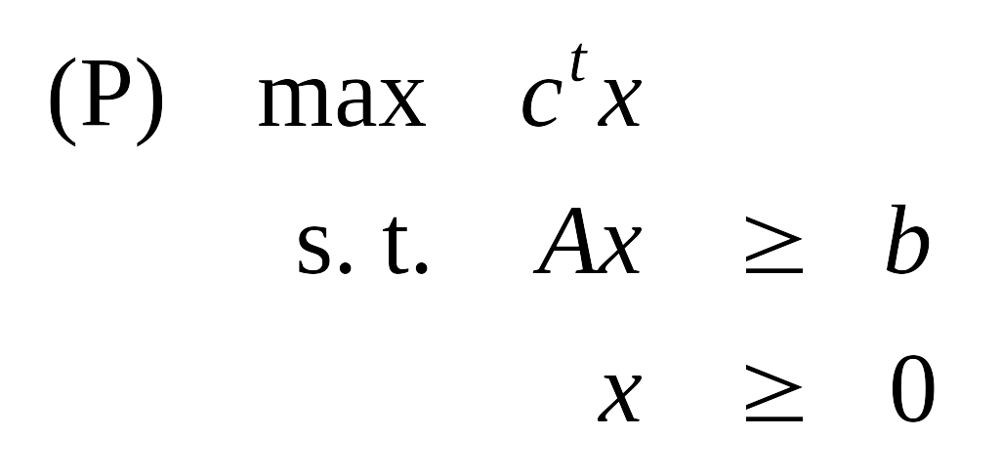
Linear Programming
Linear programming. Max/min linear objective function subject to linear inequalities.
  Input: integers c_{j}, b_{i}, a_{ij} .
  Output: real numbers x_{j}.
Linear. No x², xy, arccos(x), x(1-x), etc.
Simplex algorithm. [Dantzig 1947] Can solve LP in practice.
Ellipsoid algorithm. [Khachian 1979] Can solve LP in poly-time.
Notes:
Solving simultaneous linear equations (Ax = b) can be accomplished using Gaussian elimination. LP is a generalization with inequalities instead of equalities.
Note: simple transformations to handle >= inequalities, unrestricted variables, or min objective

Slide 34
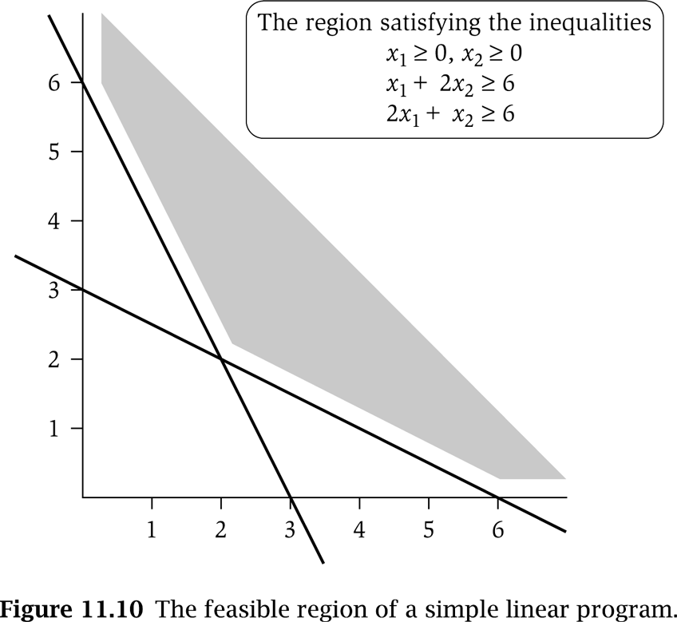
LP Feasible Region
LP geometry in 2D.
x₁ = 0
x₂ = 0
x₁ + 2x₂ = 6
2x₁ + x₂ = 6

Slide 35
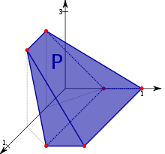
LP Feasible Region
LP geometry in 3D.
Graph is from Wikipiedia.com http://en.wikipedia.org/wiki/Linear_programming

Slide 36
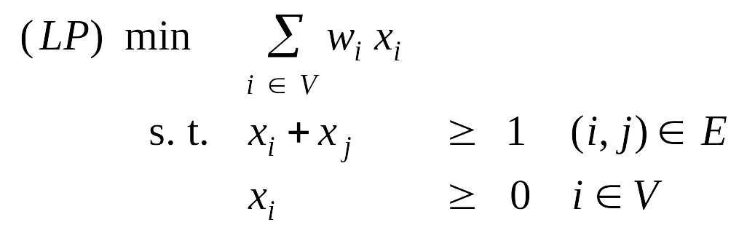
Weighted Vertex Cover: LP Relaxation
Weighted vertex cover. Linear programming formulation.
Observation. Optimal value of (LP) is ≤ optimal value of (ILP).
Pf. LP has fewer constraints.
Note. LP is not equivalent to vertex cover.
Q. How can solving LP help us find a small vertex cover?
A. Solve LP and round fractional values.
½
½
½
Notes:
LP relaxation is a useful lower bound for designing approximation algorithms.

Slide 37
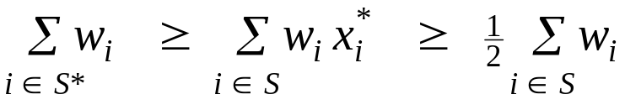
Weighted Vertex Cover
Theorem. If x* is optimal solution to (LP), then S = {i ∈ V : x*_{i} ≥ ½} is a vertex cover whose weight is at most twice the min possible weight.
Pf. [S is a vertex cover]
  Consider an edge (i, j) ∈ E.
  Since x*_{i} + x*_{j} ≥ 1, either x*_{i} ≥ ½ or x*_{j} ≥ ½ ⇒ (i, j) covered.
Pf. [S has desired cost]
  Let S* be optimal vertex cover. Then
LP is a relaxation
x*_{i} ≥ ½

Slide 38
Weighted Vertex Cover
Theorem. 2-approximation algorithm for weighted vertex cover.
Theorem. [Dinur-Safra 2001] If P ≠ NP, then no ρ-approximation
for ρ < 1.3607, even with unit weights.
Open research problem. Close the gap.
10 √5 - 21
Notes:
NP-hard even on 3-regular planar graphs with unit weights.

Slide 39
11.8 Knapsack Problem

Slide 40
Polynomial Time Approximation Scheme
PTAS. (1 + ε)-approximation algorithm for any constant ε > 0.
  Load balancing. [Hochbaum-Shmoys 1987]
  Euclidean TSP (travel salesman problem). [Arora 1996]
Consequence. PTAS produces arbitrarily high quality solution, but trades off accuracy for time.
This section. PTAS for knapsack problem via rounding and scaling.

Slide 41
Knapsack Problem
Knapsack problem.
  Given n objects and a "knapsack."
  Item i has value v_{i} > 0 and weighs w_{i} > 0.
  Knapsack can carry weight up to W.
  Goal: fill knapsack so as to maximize total value.
Ex: { 3, 4 } has value 40.
we'll assume w_{i} ≤ W
Item
Value
Weight
1
1
1
2
6
2
W = 11
3
18
5
4
22
6
5
28
7

Slide 42
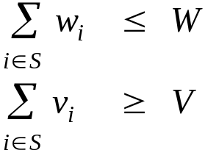
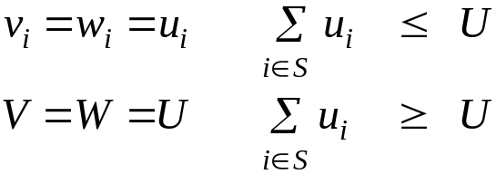
Knapsack is NP-Complete
KNAPSACK: Given a finite set X, nonnegative weights w_{i}, nonnegative values v_{i}, a weight limit W, and a target value V, is there a subset S ⊆ X such that:
SUBSET-SUM: Given a finite set X, nonnegative values u_{i}, and an integer U, is there a subset S ⊆ X whose elements sum to exactly U?
Claim. SUBSET-SUM ≤ _{P} KNAPSACK.
Pf. Given instance (u₁, …, u_{n}, U) of SUBSET-SUM, create KNAPSACK instance:

Slide 43
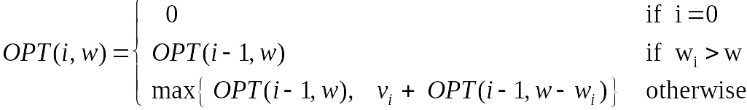
Knapsack Problem: Dynamic Programming 1
Def. OPT(i, w) = max value subset of items 1,..., i with weight limit w.
  Case 1: OPT does not select item i.
    OPT selects best of 1, …, i–1 using up to weight limit w
  Case 2: OPT selects item i.
    new weight limit = w – w_{i}
    OPT selects best of 1, …, i–1 using up to weight limit w – w_{i}
Running time. O(n W). (introduced in ‘06dynamic-programming.ppt’ lecture notes)
  W = weight limit.
  Not polynomial in input size!

Slide 44
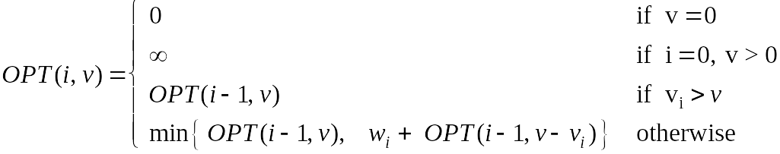
Knapsack Problem: Dynamic Programming II
Def. OPT(i, v) = min weight subset of items 1, …, i that yields value exactly v.
  Case 1: OPT does not select item i.
    OPT selects best of 1, …, i-1 that achieves exactly value v
  Case 2: OPT selects item i.
    consumes weight w_{i}, add new value of v_{i}, which means:
    OPT selects best of 1, …, i-1 that achieves exactly value v- v_{i}.
Running time. O(n V*) = O(n² v_{max}).
  V* = optimal value = maximum v such that OPT(n, v) ≤ W.
  Not polynomial in input size!
V* ≤ n v_{max}

Slide 45
Knapsack: FPTAS
Intuition for approximation algorithm.
  Round all values up to lie in smaller range.
  Run dynamic programming algorithm on rounded instance.
  Return optimal items in rounded instance.
  FPTAS: Fully Polynomial Time. Approximation Schemes
Item
Value
Weight
Item
Value
Weight
1
934,221
1
1
1
1
2
5,956,342
2
2
6
2
3
17,810,013
5
3
18
5
4
21,217,800
6
4
22
6
5
27,343,199
7
5
28
7
W = 11
W = 11
original instance
rounded instance

Slide 46
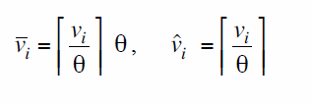




Knapsack: FPTAS
Knapsack FPTAS. Round up all values:
    v_{max} = largest value in original instance
    ε = precision parameter
    θ = scaling factor = ε v_{max} / n
Observation. Optimal solution to problems with or are equivalent.
Intuition. close to v so optimal solution using is nearly optimal;
small and integral so dynamic programming algorithm is fast.
Running time. O(n³ / ε).
  Dynamic program II running time is , where

Slide 47


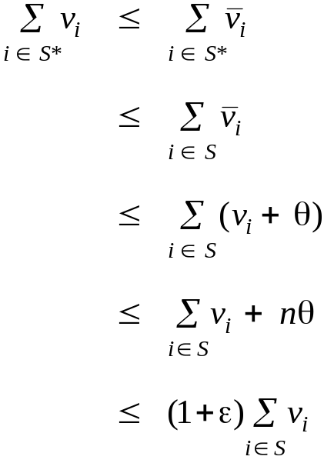
Knapsack: FPTAS
Knapsack FPTAS. Round up all values:
Theorem. If S is solution found by our algorithm and S* is any other feasible solution then
Pf. Let S* be any feasible solution satisfying weight constraint.
always round up
solve rounded instance optimally
never round up by more than θ
|S| ≤ n
DP alg can take v_{max}
n θ = ε v_{max}, v_{max} ≤ Σ_{i∈S} v_{i}
Original problem assumes no individual item has weight w_n that exceeds weight limit W all by itself
Notes:
WLOG assume no individual item has weight w_n that exceeds weight limit W all by itself

